Slide 1

Cryptography and Network Security: Safeguarding Digital Communication
Mirna Farahat
Notes:
Hello, everyone! I'm Mirna Farahat, and today I'll be presenting on "Cryptography and Network Security." Cryptography is the practice of securing communication by transforming plaintext into ciphertext. It plays a crucial role in network security, ensuring confidentiality, integrity, and authenticity of digital communication. Let's explore the key concepts!

Slide 2

Introduction
Definition of cryptography: Cryptography refers to the practice of securing communication by transforming plaintext into ciphertext, preventing unauthorized access.
Significance of cryptography in network security: Cryptography plays a vital role in ensuring the confidentiality, integrity, and authenticity of digital communication, safeguarding sensitive information and preventing unauthorized alterations.
Notes:
Cryptography is the foundation of modern-day secure communication. It involves converting readable information, called plaintext, into an unreadable form, called ciphertext. This transformation makes it extremely difficult for unauthorized individuals to access or understand the original information.

Slide 3

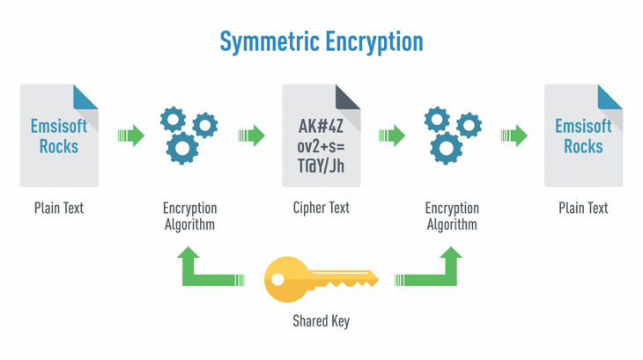
Symmetric Encryption
Symmetric encryption uses a single key for both encryption and decryption. Popular algorithms include AES and DES. Key management is crucial for maintaining communication confidentiality.
Notes:
Symmetric encryption, also known as secret-key encryption, uses a single key for both encryption and decryption. The same key is shared between the sender and the recipient. When the sender wants to send an encrypted message, they apply the key to convert the plaintext into ciphertext. The recipient, using the same key, can then decrypt the ciphertext back into the original plaintext.
For example, the Advanced Encryption Standard (AES) is a widely used symmetric encryption algorithm. It employs a key length of 128, 192, or 256 bits, making it highly secure. AES has been adopted as the standard encryption algorithm by the U.S. government and is used in various applications to protect sensitive data.

Slide 4

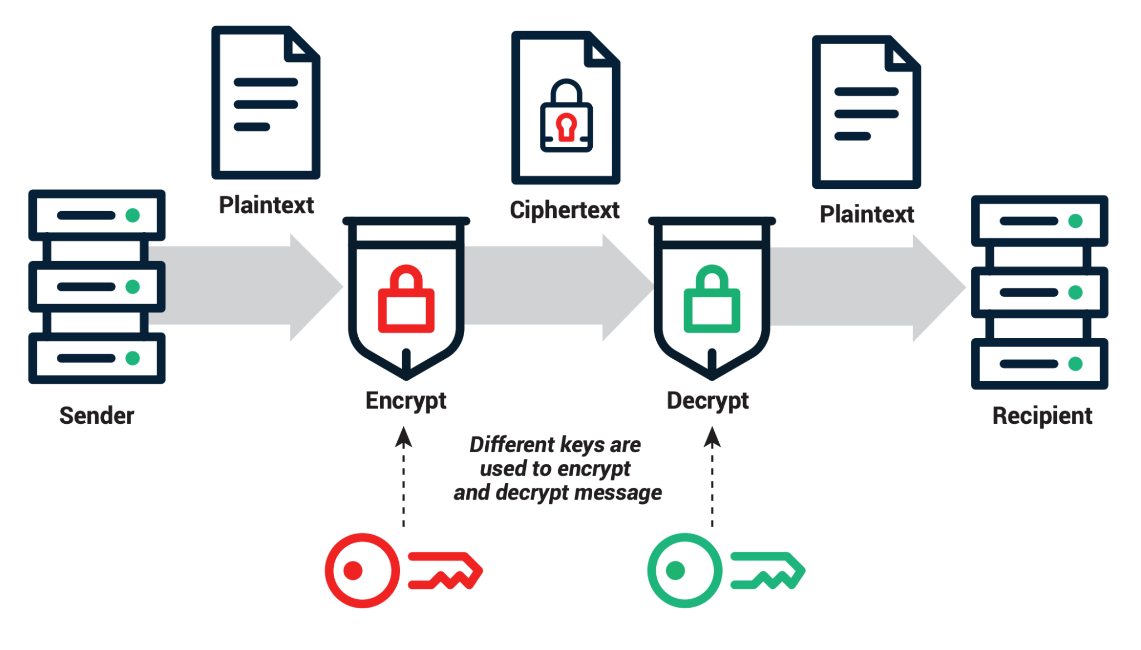
Asymmetric Encryption
Asymmetric encryption employs a pair of keys - public and private. Examples include RSA and Diffie-Hellman. The security lies in the complexity of deriving the private key from the public key.
Notes:
Asymmetric encryption, also known as public-key encryption, uses a pair of mathematically related keys: a public key and a private key. The public key is freely available to anyone, while the private key is kept secret by its owner. When someone wants to send an encrypted message, they use the recipient's public key to encrypt it. Only the recipient, who possesses the corresponding private key, can decrypt the message.
RSA is one of the most widely used asymmetric encryption algorithms. It relies on the difficulty of factoring large composite numbers into their prime factors. This mathematical problem forms the basis of RSA's security. Another popular algorithm is Diffie-Hellman, which allows two parties to securely establish a shared secret key over an insecure channel.

Slide 5

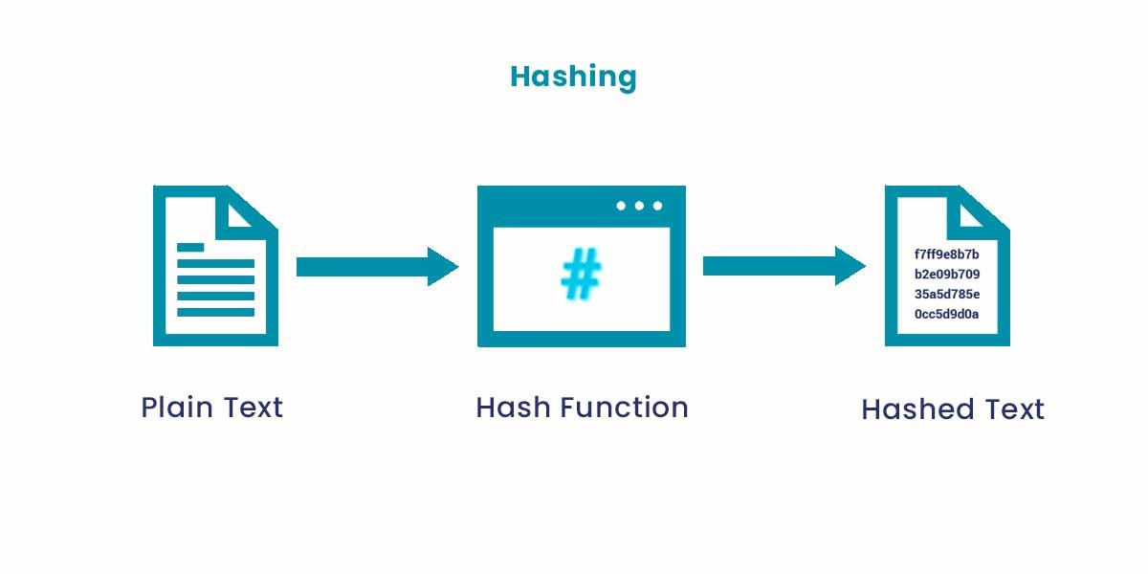
Hash Functions
Definition and properties of hash functions: Convert input to fixed-size hash value with properties like determinism, preimage resistance, and collision resistance.
Applications in network security: Data integrity, document authentication, password storage.
Examples of hash functions: SHA-256, MD5.
Notes:
Hash functions are essential cryptographic tools used to verify data integrity. They take an input of any length and produce a fixed-size output, known as a hash value or hash digest. Even a small change in the input data will result in a significantly different hash value.
Hash functions are commonly used to store passwords securely. Instead of storing the actual passwords, the hash values of passwords are stored. When a user enters their password during authentication, it is hashed, and the resulting hash value is compared with the stored hash value. This way, even if the password database is compromised, the actual passwords remain hidden.

Slide 6

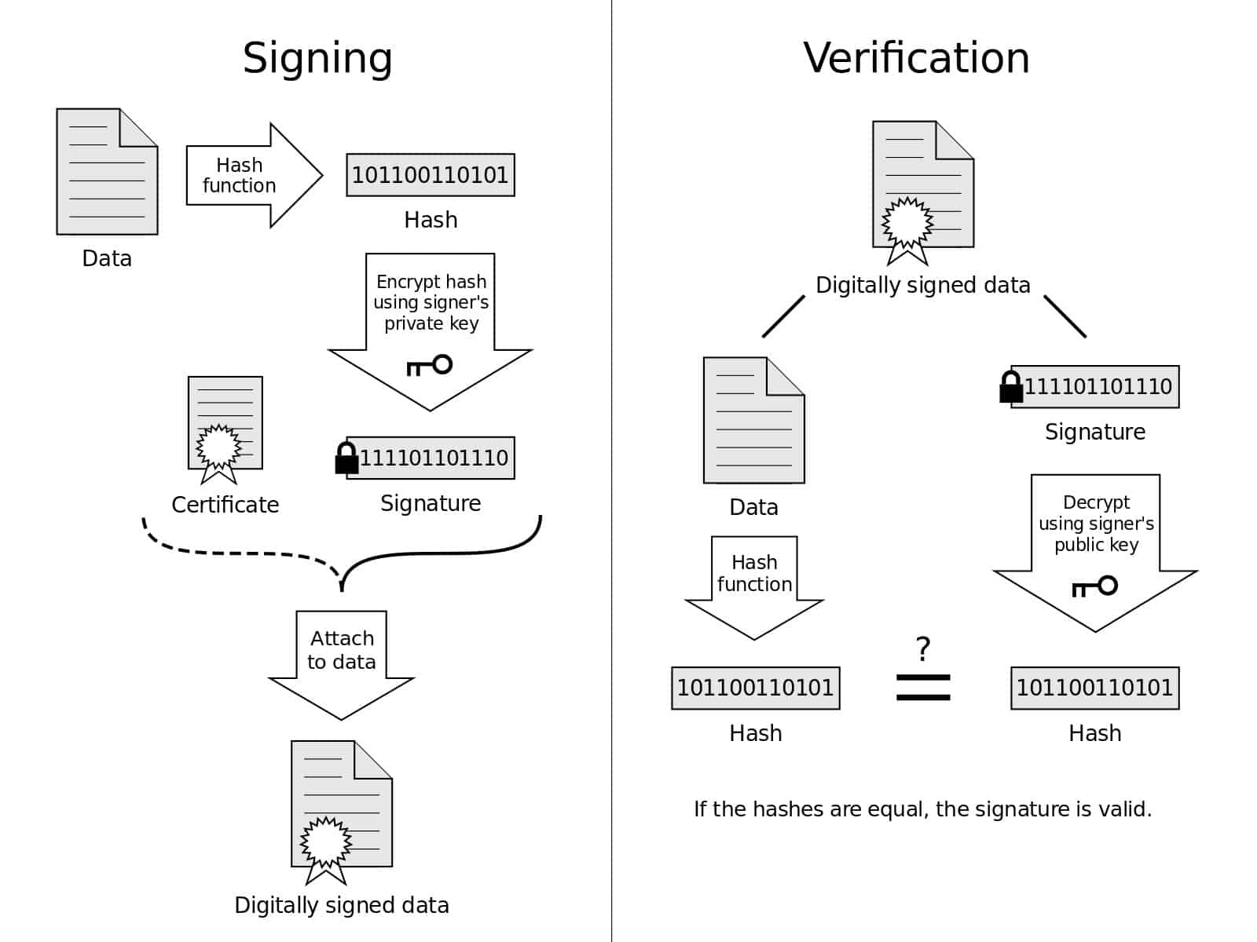
Digital Signatures
Purpose and significance of digital signatures: Assure message integrity, non-repudiation, and authenticity.
Process of creating and verifying digital signatures: Sender signs with private key, receiver verifies with public key.
Applications: Electronic transactions, document signing, authentication protocols.
Notes:
Digital signatures provide a way to verify the authenticity and integrity of digital documents. They are created using the signer's private key and can be verified using the corresponding public key. Digital signatures ensure that the document has not been tampered with and that it was indeed signed by the claimed signer.
For example, in electronic transactions, digital signatures are used to ensure the integrity of financial transactions, contracts, and other important documents. They provide a reliable means of verifying the authenticity of the parties involved and protect against tampering or forgery.

Slide 7

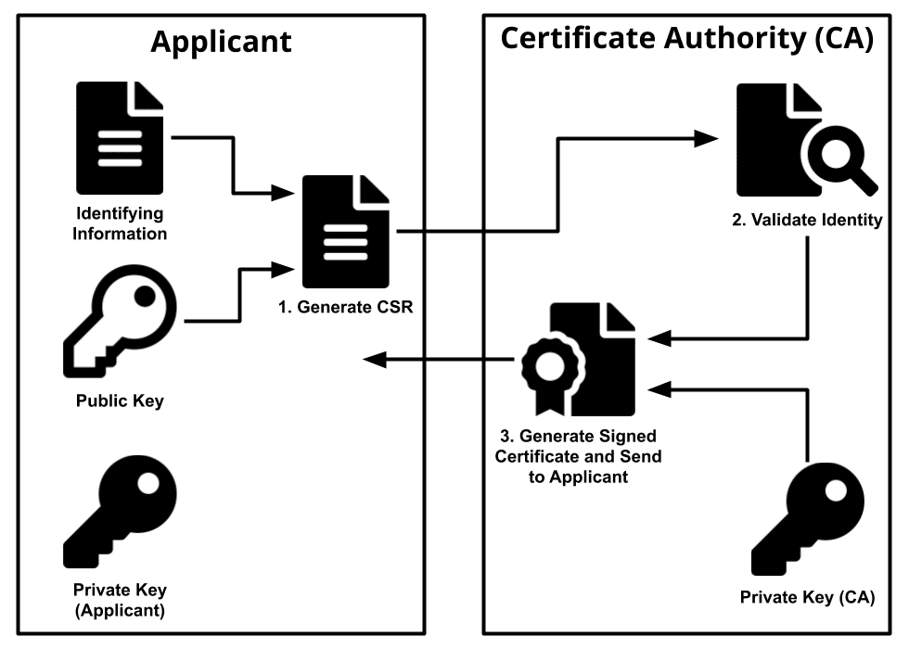
Public Key Infrastructure (PKI)
Overview of PKI: Manages digital certificates for verifying identities.
Certificate authorities and digital certificates: Issued by CAs to bind public keys to entities.
Ensures authenticity and integrity of digital communication
Notes:
Public Key Infrastructure (PKI) is a framework that enables the secure management, distribution, and revocation of digital certificates. A digital certificate is an electronic document issued by a trusted third-party organization called a Certificate Authority (CA). It
binds an entity's public key to its identity, providing assurance of the entity's authenticity.
PKI ensures the secure exchange of information in various applications, such as secure email, e-commerce transactions, and virtual private networks (VPNs). By relying on trusted digital certificates, PKI establishes a hierarchy of trust, enabling parties to verify each other's identities and ensure secure communication.

Slide 8

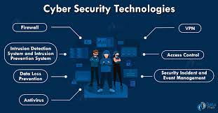
Challenges and Future Trends
Common challenges: Key management, secure communication in the presence of adversaries, adapting to emerging threats.
Emerging trends: Quantum cryptography, homomorphic encryption, post-quantum cryptography.
Notes:
While cryptography has come a long way in ensuring secure communication, there are still challenges and emerging trends that deserve attention. Key management is a significant challenge, especially in large-scale systems where the secure distribution and storage of keys become complex.
Additionally, as technology advances, new threats and vulnerabilities emerge. For example, the advent of quantum computing poses a potential threat to traditional cryptographic algorithms. Researchers are exploring new cryptographic techniques, such as quantum cryptography and post-quantum cryptography, to address these challenges.

Slide 9

Conclusion
Recap of key points: Cryptography ensures confidentiality, integrity, and authenticity in digital communication.
Importance of cryptography and network security: Protects sensitive information in an interconnected world.
Notes:
In conclusion, cryptography plays a vital role in maintaining the security and integrity of digital communication. Through symmetric encryption, asymmetric encryption, hash functions, digital signatures, and PKI, we can ensure the confidentiality, integrity, and authenticity of our digital transactions and communications.
As we continue to face new challenges and advancements, the field of cryptography will evolve to provide stronger security measures. It is an exciting and dynamic field that will shape the future of secure communication in our increasingly connected world.

Slide 10

References
Rosen, K. H. (2019). Discrete Mathematics and Its Applications (8th ed.). McGraw-Hill Education
Stallings, W. (2017). Cryptography and Network Security: Principles and Practice (7th ed.). Pearson.
Paar, C., Pelzl, J., & Preneel, B. (2010). Understanding Cryptography: A Textbook for Students and Practitioners. Springer
Notes:
Here are the references for further reading and in-depth understanding.
Thank you all for your attention! I hope this presentation provides valuable insights into cryptography and network security. I'm now open to any questions or discussions you may have.

